Slide 1
Measuring the impact of VACCINE X using mortality and/or administrative hospitalization data COUNTRY X
Place, date

Slide 2
Country characterization
Location
Total population
Children
GDP/capita
HDI index (around vaccine introduction)

Slide 3
Background – Vaccine X
Vaccine X – introduction
Date
Schedule
Target population
Any changes in Sschedule or vaccine used

Slide 4
Vaccine Coverage in COUNTRY (DATES)
Uptake of the vaccine reached XX % within one year of implementation.

Slide 5
Study General objectives

Slide 6
Specific Objectives

Slide 7
Methods
Interrupted time series analysis
Secondary data from DATASOURCE
Describe data sources
Population data
Describe data sources
Vaccine coverage data
Describe data sources
Socio economic indicators
Describe indicators and sources

Slide 8
Descriptive Results

Slide 9
Population

Slide 10
Deaths or HOSPITALIZATIONS

Slide 11
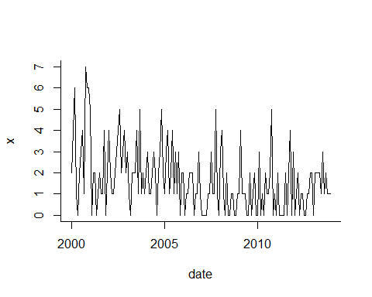
Pneumonias – Main cause of Death

Slide 12
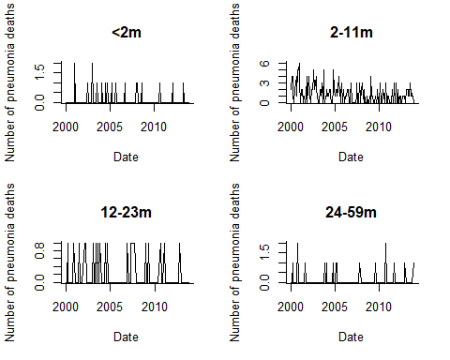
Pneumonia deaths by age sub-groups

Slide 13
All deaths – by any cause by age group

Slide 14
% pneumonia deaths and other respiratory deaths by age groups
| neumonías otras
etario | respirat.| Total
-----------+----------------------+----------
<1a | 80,149 9,853,288 | 9,933,437
| 0.81 99.19 | 100.00
-----------+----------------------+----------
1 - <2a | 53,670 7,083,346 | 7,137,016
| 0.75 99.25 | 100.00
-----------+----------------------+----------
2 - <5a | 60,022 13,081,036 |13,141,058
| 0.46 99.54 | 100.00
-----------+----------------------+----------
Total | 193,841 30,017,670 |30,211,511
| 0.64 99.36 | 100.00

Slide 15
Socio-economic indicators

Slide 16
Results Time Series Analysis

Slide 17
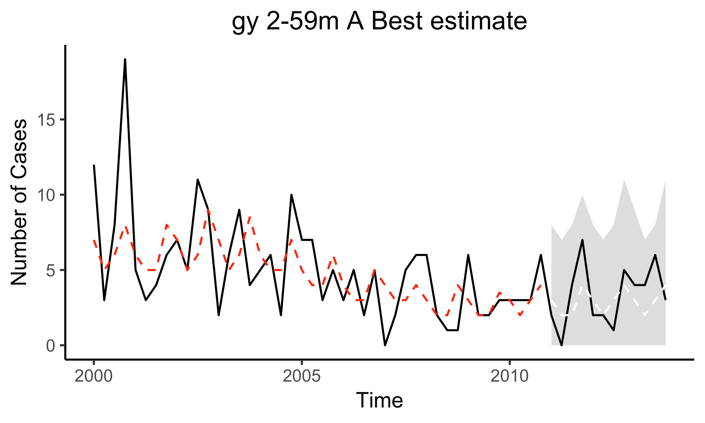
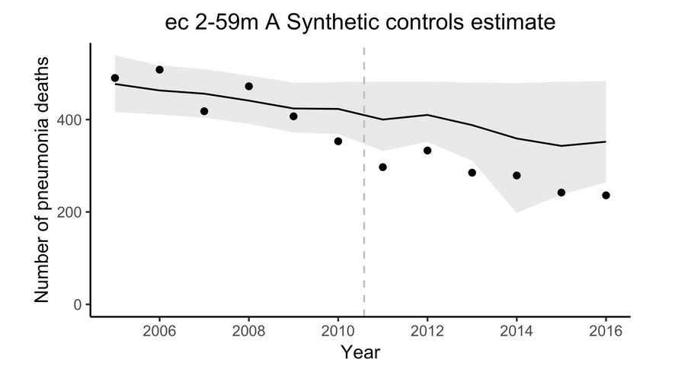
Changes in pneumonia deaths following introduction of VACCINE in COUNTRY

Slide 18
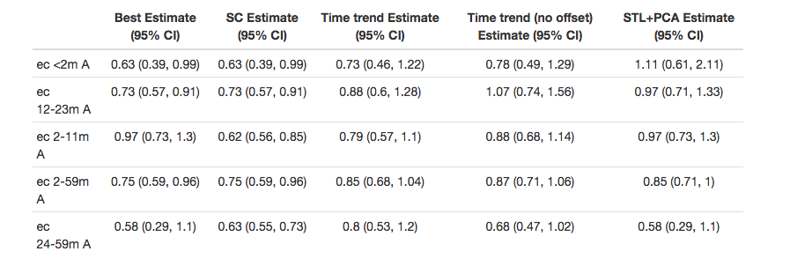
Changes in pneumonia deaths following introduction of VACCINE in COUNTRY

Slide 19
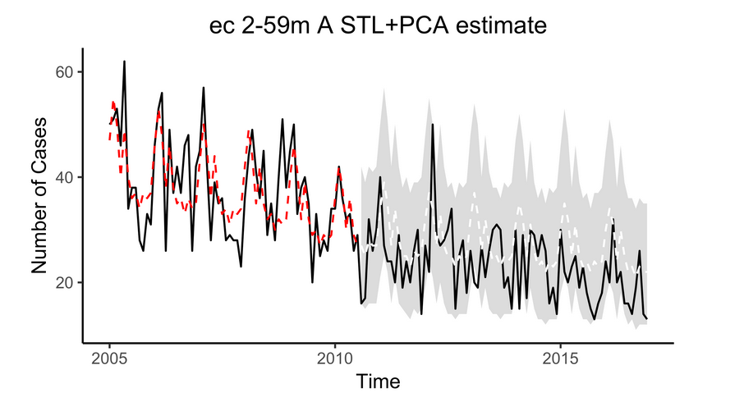

Slide 20
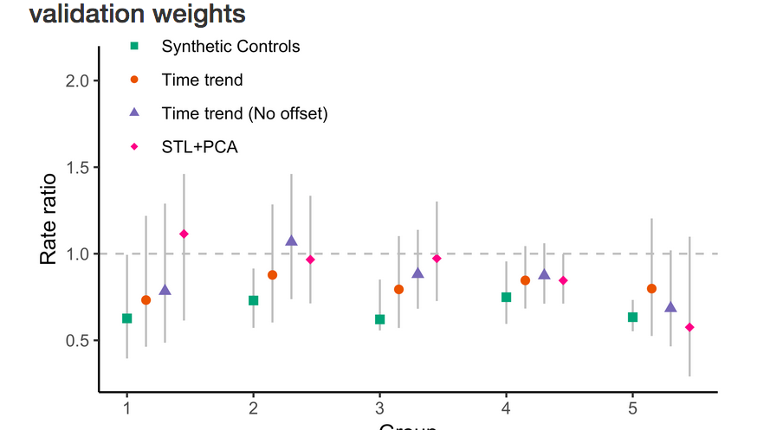

Slide 21
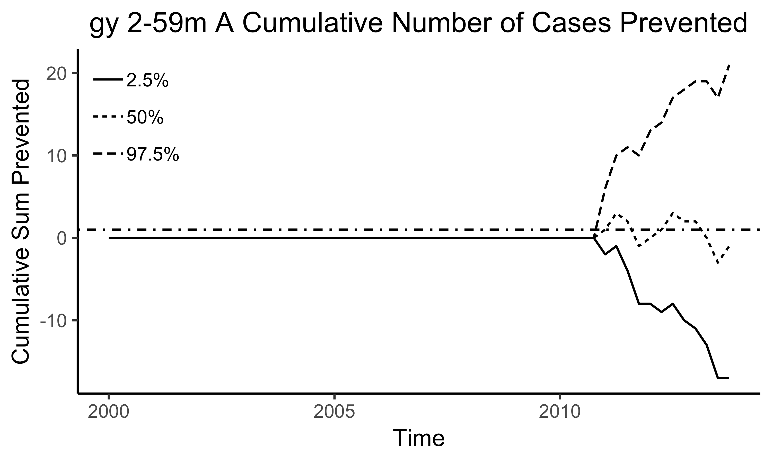
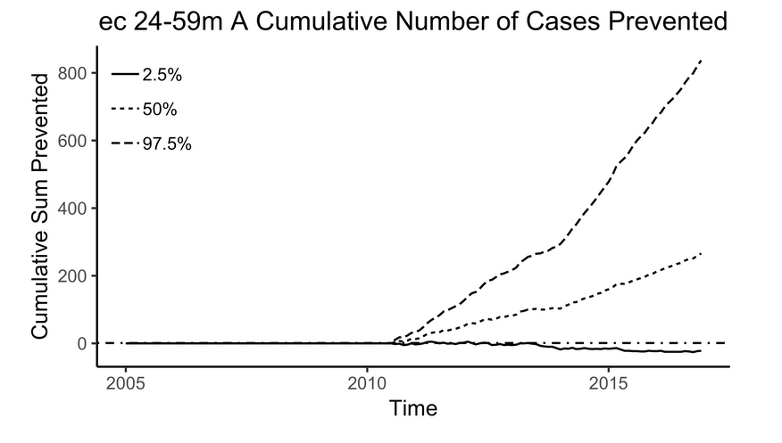
Averted Deaths in Country X

Slide 22
Changes in pneumonia deaths following introduction of VACCINE in COUNTRY
Pneumonia deaths reduced/did not reduce significantly by YY (IC 95%: XX-ZZ) in children aged X to y m

Slide 23
Conclusions

Slide 24
Challenges

